Slide 1
Final Capstone
Mark De Leon

Slide 2
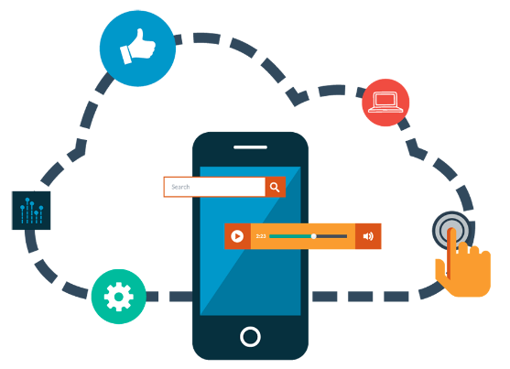
Intro
In our society, the way of life has changed dramatically when it comes to lifestyle and the way we do things. We have the latest technology and cellular devices; the world is at our finger tips.
When it comes to reading, listening to music, and even checking emails, our handheld device can do it all.
Now let’s talk about everyone’s favorite subject, food!– With these devices we can place an order, or even have food delivered without speaking to anyone at the business of choice.
We can even look by location, food of origin, and even reviews.

Slide 3
Hypothesis
Is there a statistical difference between the various ratings attributed to customer experience, which has an affect of business and what they offer?
One theory is that: There is no statistical difference between review counts with a star rating above 3.5 and below 3.5.
An experimental point is that there is a statistical difference between review counts with a star rating 3.5 and below 3.5.
We will explore this data from a well known web-application – Yelp!

Slide 4
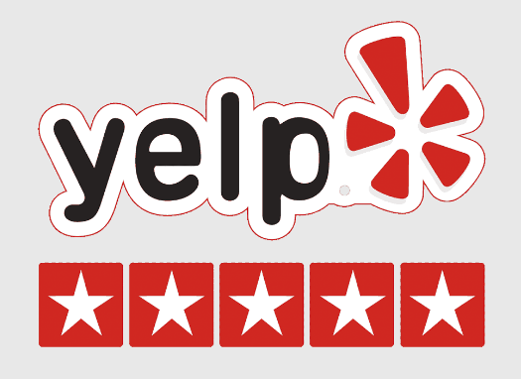
Yelp
Yelp is an American public company headquartered in San Francisco, California.
The company develops, hosts, and markets the Yelp.com website and the Yelp mobile app, which public crowd-sourced reviews about businesses.
With Yelp used globally, someone can potentially be anywhere and read about a business or restaurant without leaving their house!
By scraping the data used, it is from aggregated check-ins over time for 209,393 business – over a span of 10 metropolitan areas.
With a little over 8M reviews, business attributes have been regarded or lack there-of.

Slide 5
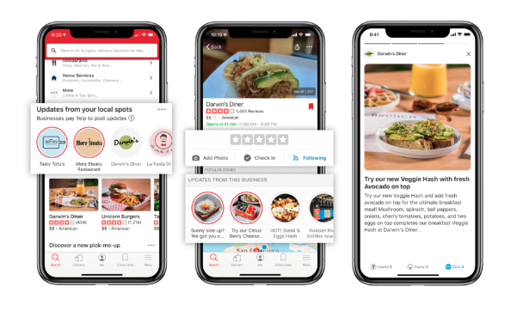
Background
Yelp has a star rating system ranging from 1-5.
Users can also post pictures and write reviews.
Businesses can showcase their company by listing everything that they offer.
To name a few:
Wifi
Pricing
Parking
Accepts credit cards
Type of ambiance
Hours of operation
Etc.

Slide 6
Background Cont.
With 5 stars being the highest, users can filter their search for the highest; and then read reviews.
This is where those businesses can surpass their competitors. Of course, customers want the best, so they will look for the best.
Ultimately, if your business is not quite favored – it will be known.
And this is where the fine line can be drawn – and potentially help make a change.

Slide 7
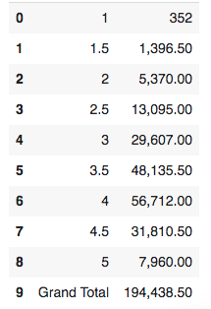
The Star Rating
By scaling and analyzing the dataset, the chart shows an aggregated list of the Star Ratings and how many reviews coincide.
It’s clear to see that those ratings who have 3.5 and above have significant more reviews than those below.

Slide 8
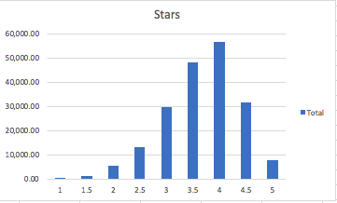
Looking into Successful Restaurants
These restaurants have attributes that create an environment that customers would enjoy and would want to return to continue business.
Examples of attributes are:
Wifi, Parking, Reservations, Delivery, Ambiance, and last but certainly not the least, testimonials

Slide 9
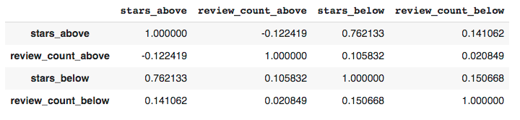
The Other Side
According to the chart above – a correlation test; we see that there is a strong correlation between two different categories:
With star ratings above – will have high count in reviews
With star ratings below – will have low count in reviews

Slide 10
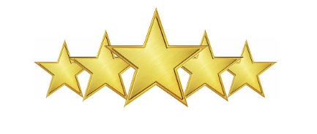
Results
After analyzing our data, we can conclude that our first hypothesis of not having a statistical difference is false. In multiple facets, and possibly more, we can prove that there are differences between those with higher than compared to those with lower review counts.
We can also validate this hypothesis comparing them to the star rating.

Slide 11
Recommendations
After looking at our analysis, it would be advisable for establishments/business not only focus on the food, but a much better customer experience – by adding attributes to create a more pleasant experience for the customers.
Why?
As consumers ourselves, we always look for what is the “best.” In our eyes, that is those who have the highest rating and the best reviews.
When you have all that, it is safe to say that you will see the same results.

Slide 12
Final Thought
Businesses start with a mission. To become profitable and gain more customers – which results in more revenue.
This goal will be unattainable if a business does not move forward with the time.
Embrace and accept change – look what others are offering, compare to what you currently have.
If this sparks your interest – we can dive into more specific data like the state in where you business is and what attributes your competitors are offering.

